Slide 1



NUTRIZEN
FINDING BALANCE THROUGH NUTRITION

Slide 2


INTRODUCTION
Introducing NutriZen: Embark on Your Wellness Journey
Unlock a healthier, happier lifestyle with NutriZen.
Our mission is to empower you with expert knowledge and personalized plans, guiding you towards optimal well-being.
Our team of experienced nutritionists, fitness experts, and health enthusiasts is dedicated to providing evidence-based insights on health, diet, and nutrition.
From tailored diet plans to effective workout programs and expert counseling, we're here for every step of your transformation.
Join us in nurturing your body, mind, and soul for resilience and vibrancy. Discover the joy of living your best life with NutriZen.

Slide 3







NUTRIZEN PROVIDES
PERSONALIZED DIET PLANS
WORKOUT PROGRAMS

Slide 4
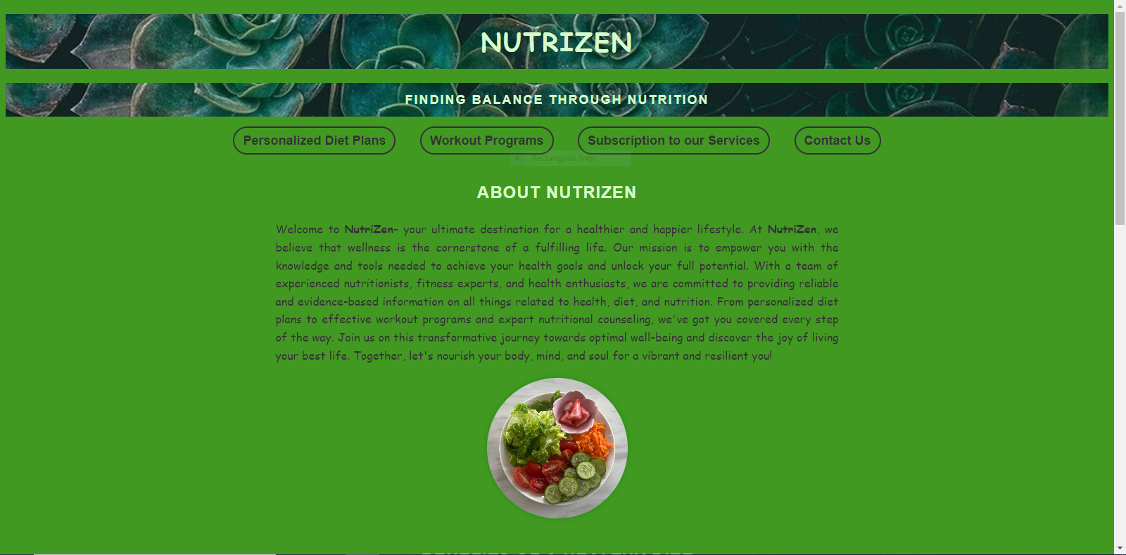

Slide 5


Slide 6


Slide 7
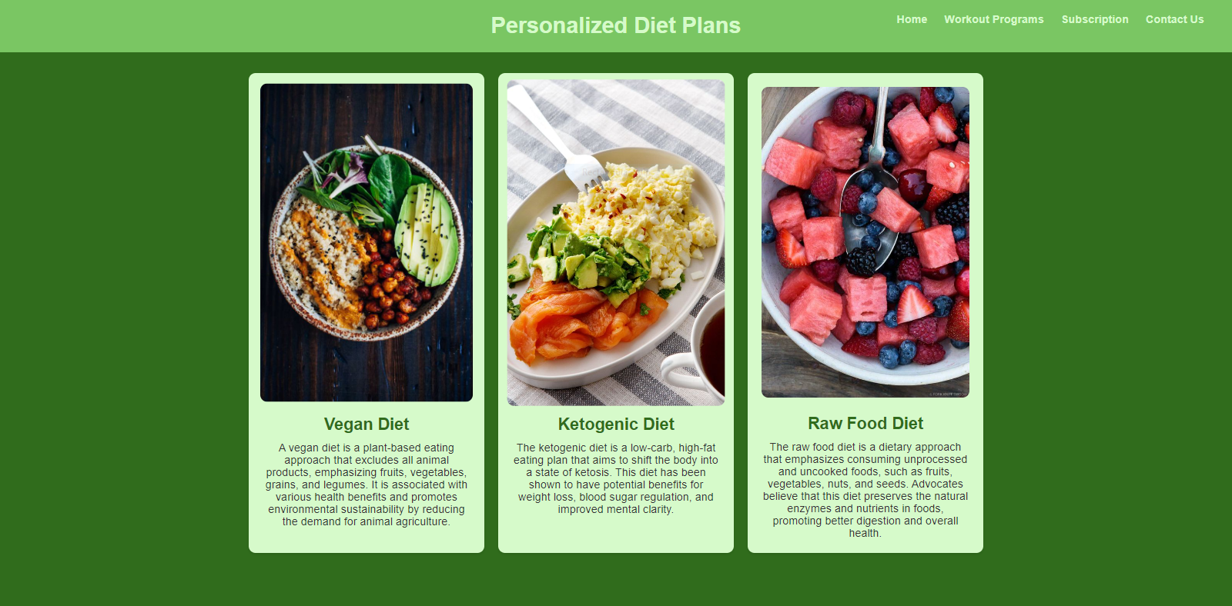

Slide 8
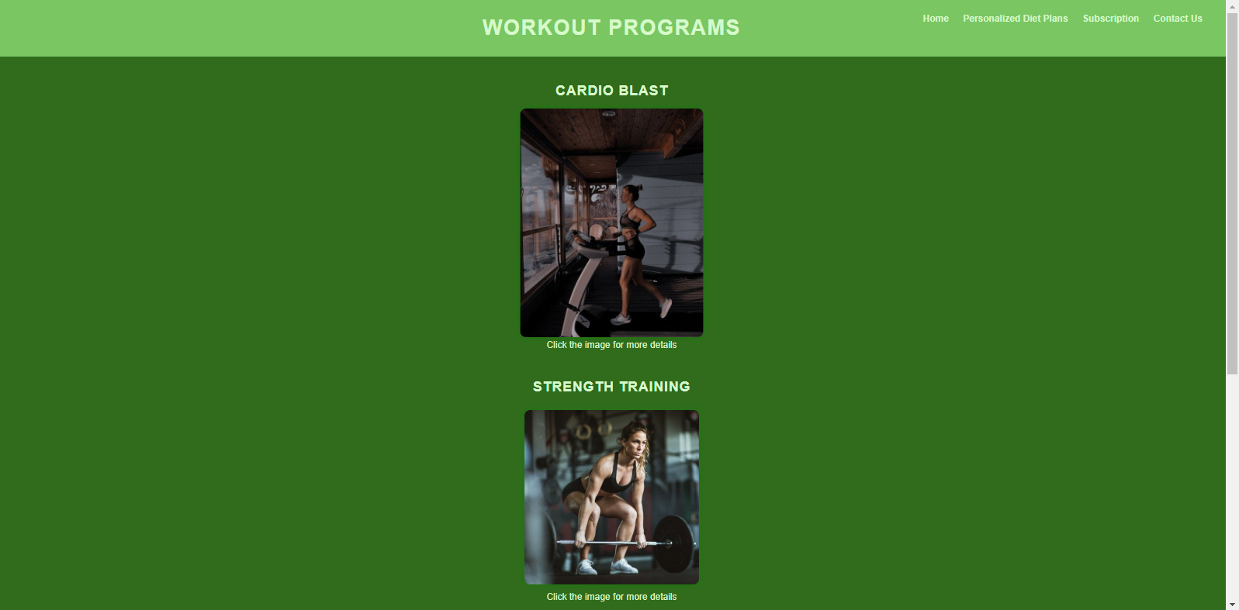

Slide 9


Slide 10
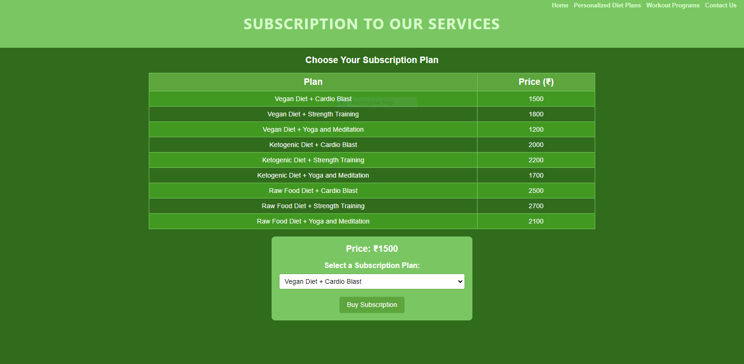

Slide 11
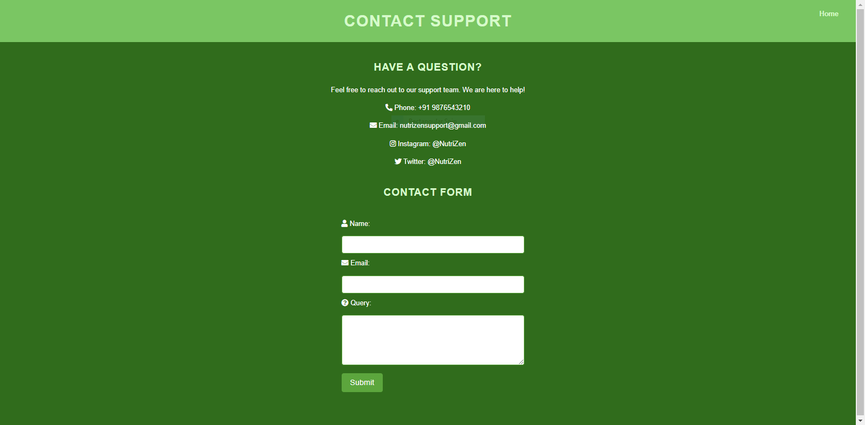

Slide 12



WHY SHOULD YOU CHOOSE NUTRIZEN
CHOOSE YOUR IDEAL DIET PLAN BASED ON YOUR PREFERENCES.
EXPERIENCE TRAINING EXCELLENCE WITH OUR TOP-NOTCH TRAINERS.
WORKOUT PROGRAMS THAT LETS YOU CHOOSE TO FOCUS ON EITHER CARDIO, STRENGTH TRAINING OR YOGA.
PROMPT CUSTOMER SUPPORT

Slide 13


USE OF NUTRIZEN WEBSITE IN DAILY LIFE
The NutriZen website can be your daily health companion:
Nutrition Guidance: Get personalized meal plans.
Effective Workouts: Follow tailored exercise routines.
Healthy Lifestyle Tips: Discover wellness insights for better living.
Expert Support: Reach out for advice anytime

Slide 14

THE FUTURE IMPORTANCE OF NUTRIZEN WEBSITE
Personalized Health Insights: Get tailored health insights and recommendations based on your progress and preferences.
Community Connection: Connect with like-minded individuals and experts, fostering a supportive community for your health journey.
Enhanced Accessibility: Embrace technology's future, accessing NutriZen's resources seamlessly on various devices

Slide 15











CONCLUSION
We appreciate your time spent exploring our NutriZen platform!
We hope you've gained insights into the advantages of our tailored wellness solutions and the adaptability NutriZen brings to the table.

Slide 16
Thank
you!

